Slide 1
Approaching an ML Problem
Geoff Hulten

Slide 2
Blink Detection
Iris Login
Self-driving Cars
Gaze tracking
Use in games

Slide 3
Important Steps
Understanding the Environment
Define Success
Get Data
Get Ready to Evaluate
Simple Heuristics
Machine Learning
Understanding Tradeoffs
Access and Iterate

Slide 4
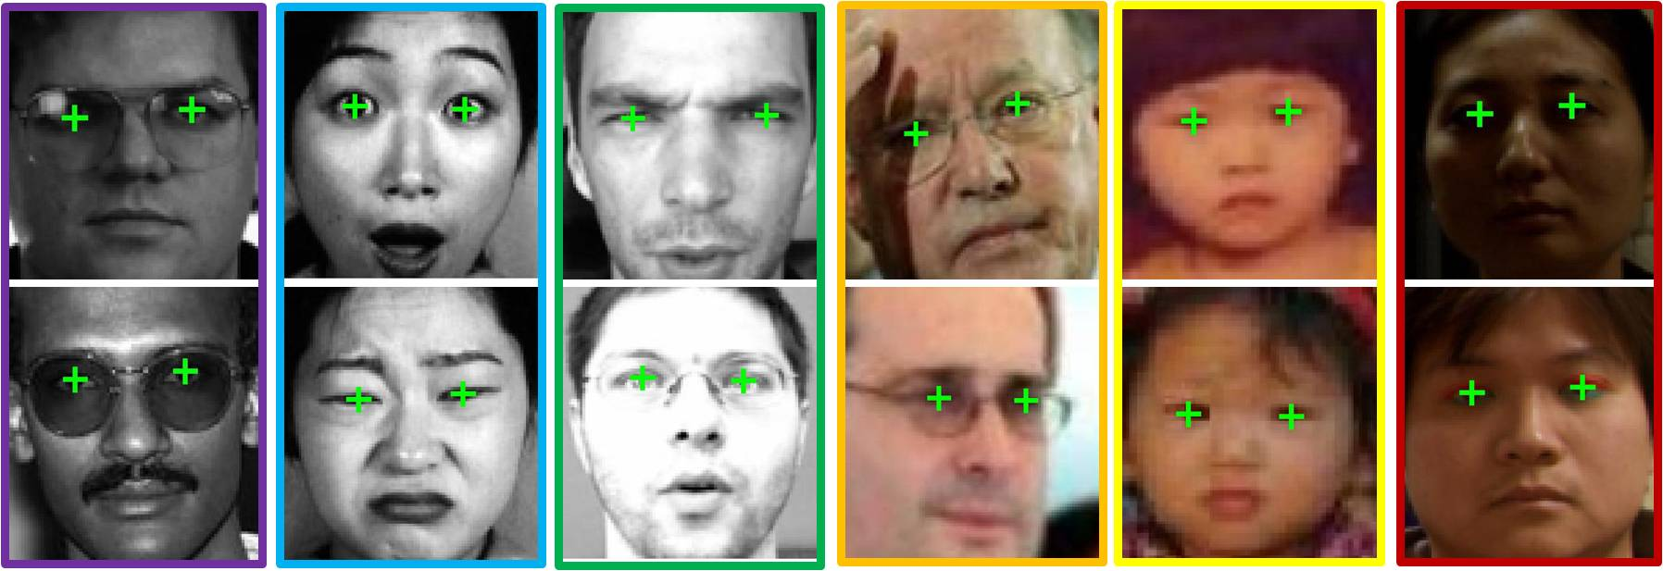
Understanding Environment
Where will input come from?
Sensor?
Standard?
Form of the input?
Image?
Video?
Preprocessing?
Image processing?
Localization?
Where will it be used?
How will it be used?
Open vs Closed?
% open?
Resources?

Slide 5
Defining Success
Good Goals
Types of Goals
Are meaningful to all participants
Are achievable
Are measurable
Model Properties
FPR/FNR
P/R
User Outcomes
(iris login) Time to log in / battery per login
(self driving) number of accidents / interaction
(gaze tracking) time to select / click
Leading Indicators
Engagement / Sentiment
Organization Objectives
Revenue

Slide 6
Get Data
Bootstrap
Usage
Web Data
Data Collection
Buy a Curated Set
Tie to performance
Implicit success and failure
Data Collection Experience

Slide 7
Collecting and Labeling Data
Data Collection
Data Labeling
Environment
Lab?
Mobile?
Usage environment?
Subjects
Coverage
Script
Staged
Performance task
Part of collection process
Pay people…
Tools
Managing thousands of lables/workflow
Dealing with noise and mistakes

Slide 8
Get Ready to Evaluate
Offline
Online
Set aside independent data
Have good coverage of users
Evaluation Framework
Telemetry
Intelligence Management
Silent/rollouts/Flights

Slide 9
Understand the Problem / Simple Heuristics
Find systematic noise, do some cleaning
Hand craft a heuristic ‘model’
A simple decision tree
A few rules
Find the challenges
Create a baseline

Slide 10
Machine Learning (pt 1)
Get a data set, contexts and labels
Load the data and labels
Set some aside to evaluate final accuracy (final test set)
Implement some basic features
Easy standard stuff for the domain
Do some runs to estimate the time it will take to train lots of models, use this to decide how much initial search to do
Use cross validation to do some parameter tuning
Look at the predictions in detail:
Accuracy, FP rate, FN rate, precision, recall, confusion
ROC curves of a couple parameter settings
Properties of the model search (training set loss vs iterations)
Learning curves of train set accuracy vs validation set accuracy
Some of the worst mistakes it is making

Slide 11
Machine Learning (pt 2)
Make improvements
More complex standard features
Custom heuristic features
Try to find more data
Clean/remove bad data (obvious noise)
Focus in on most useful areas of parameter space
Try other learning algorithms that might be better matches
Iterate for as long as you want / need to
Now build a single model with best parameter settings and all the training data (no cross validation).
Evaluate the model on the ‘final test set’
If the accuracy is about what you expect…
Start working to deploy everything

Slide 12
Understanding the Tradeoffs
Accuracy vs CPU cycles
Accuracy vs RAM
How fast is the problem changing?
Planning for Context & Features
Latency in execution
Worst (most costly) mistakes

Slide 13
Maturity in Machine Learning
You did it once
You could do it again
You could do it again easily
Someone else could do it
The computer does it
The computer does and deploys it

